Slide 1
EXPERIMENT 5 :
Data Link Layer Traffic Simulation using Packet Tracer Analysis of ARP
ALGORITHM:
Step 1:Start Packet Tracer
Step 2:Choosing Devices and Connections
Step 3. Open a name trace file and define finish procedure then close the trace file, and execute nameon trace file.
Step 4. Create two nodes that forms a network numbered 0 and 1
Step 5. Create duplex links between the nodes to form a STAR Topology
Step 6. Setup TCP Connection between n(1) and n(3)
Step 7. Apply CBR Traffic over TCP
Step 8. Schedule events and run the program

Slide 2
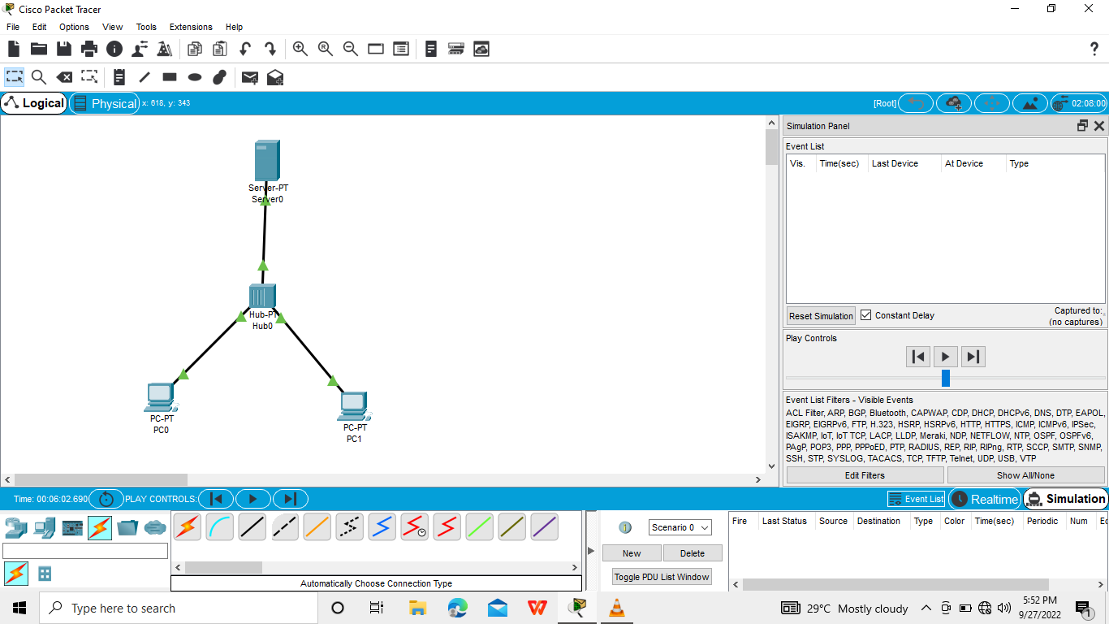
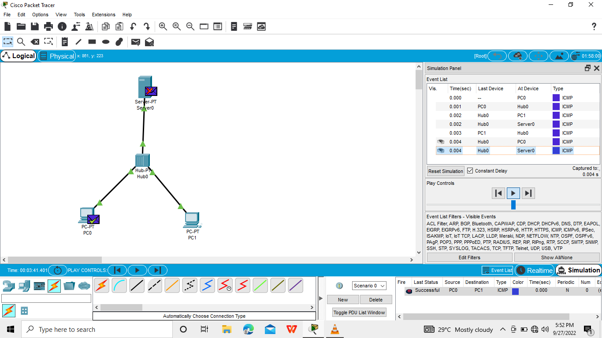

Slide 3
